Slide 1
PopMedNet Question Engine Data Partner Training
Sentinel Operations Center
Notes:
JLS: They will have no idea what QE or Question Engine mean – they won’t care. Title: PopMedNet Query Distribution

Slide 2
Overview
PopMedNet System
Question Engine Vs Existing Infrastructure (Legacy)
New Features for Data Partners
Demo of Responding to Requests
Step 1: Configuring the Datamart Client
Step 2: Opening and viewing a request
Step 3: Responding to a request

Slide 3
PopMedNet System
Web Portal / Query Tool
Web-based application
Distribute queries, receive query responses
Used by Coordinating Center, Investigators
DataMart Client
Locally-run program
Receive/respond to queries
Used by DataMart Administrators

Slide 4
Question Engine vs. Legacy
Legacy | Question Engine
Out-dated architecture requires full round trip of information to/from server (10 years old) | Browser based architecture that utilizes web services
Out-dated UI design | More responsive UI that allows for modern design (tabbed interface)
Updates and bug fixes built on top of outdated architecture | Simple to implement enhancements and bug fixes
Notes:
Legacy uses traditional web development methodology. This means that each user action requires a roundtrip of information to and from the backend server and a complete refresh of the user interface (UI). This makes the application feel sluggish to the end user. Question Engine is a browser-based current architecture that makes use of web services to talk to the server, so it feels faster and more modern. This also allows for a more sophisticated and responsive UI. For example, building a tabbed interface, like the one used in Menu-Driven Querying (MDQ), is not possible in legacy.

Slide 5
New Features and Benefits for Data Partners
Benefits of Question Engine in the DataMart (6.0+)
Simpler configuration in the DataMart Client
Enhanced visualization of summary table query parameters in the DataMart Client
Cleaner interface for modular program requests
Eliminates data storage constraint for summary table databases
Other New Features
6.9
Caching results
Auto run but not upload results
Auto run multiple requests concurrently
6.8
Open multiple DMC windows in the DMC simultaneously

Slide 6
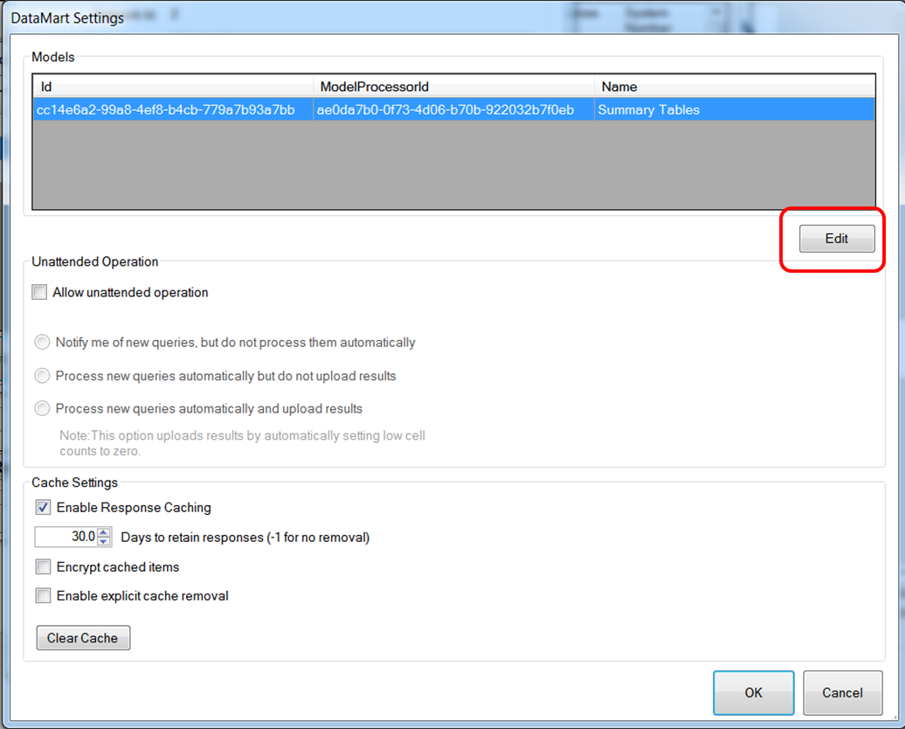
Step 1: Configuring the DataMart Client
The configuration process for a question engine compatible is the same with one key difference: only one model processor needs to be configured
The model processor called “Summary Tables” can receive summary table and file distribution/modular program queries
The determination between prevalence, incidence and MFU is now performed by the query tool

Slide 7
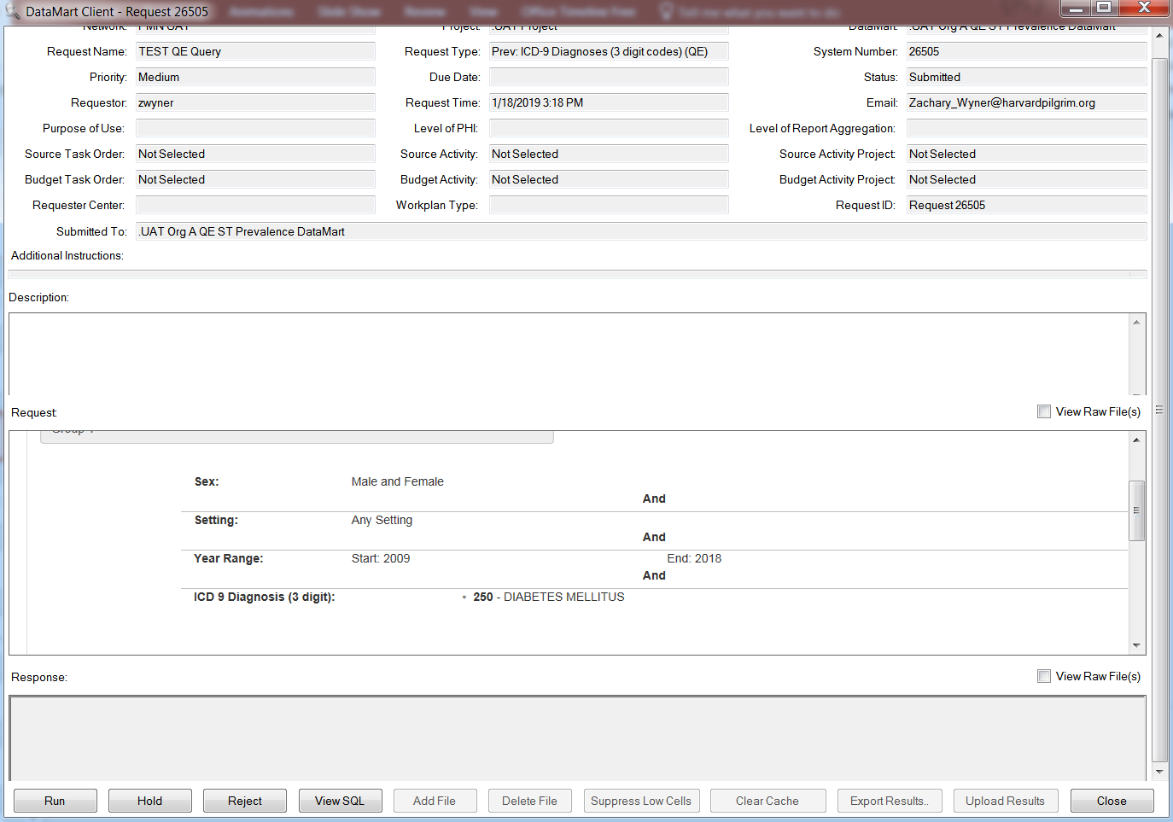
Step 2: Opening and Viewing a Request
Opening and viewing a request sent to a question engine compatible Datamart is unchanged
The request parameters are now shown in HTML format
Request shown is a summary table request

Slide 8
Step 3: Responding to a Request
Responding to a request sent to a question engine DataMart is unchanged

Slide 9
Reminder of Data Partner Action Items
Action Item | Target Due Date
Verify you can use SQL server for summary tables (SOC will follow up separately if this is not possible) | 2/09/2019
Create summary table database in SQL Server | 3/12/2019
Run a SQL query (provided by PopMedNet team) to verify correct creation of SQL server summary table database | 3/27/2019
Connect SQL server summary table database to new DataMart in DataMart Client | 4/25/2019
Execute a test query to ensure connection was successfully set up | 5/02/2019
Target due dates are subject to change
More details and instructions for the above action items will be sent by 1/29/19
Please remember to confirm your tasks in your open Question Engine Task Tracking Ticket

Slide 10
Questions and Technical References
PopMedNet User's Guide
Will be fully updated with question engine specific instructions by 2/8/19
For any issues encountered while using PMN, please contact the PopMedNet Support Desk by creating a ticket at https://popmednet.atlassian.net/servicedesk/customer/portal/1

